Slide 1
Verb – haben = to have
DEUTSCH | ENGLISH
ich habe | I have
du hast | you have
er hat sie hat es hat | he has she has it has
wir haben | we have
ihr habt | you (guys) have
sie haben | they have
Sie haben | you have

Slide 2
Trennbare Verben – Seperable Verbs
Aufstehen – to get up
here auf is a prefix added to the verb stehen. Stehen = to stand. But when the prefix auf is added the meaning of the complete verb changes which is – to get up
Q. How to conjugate such verbs/ how to use them in sentences?
Ex – Ich stehe um Sechs Uhr auf. – I get up at 6 O’ clock
Here, the verb stehen is conjugated for Ich. So it becomes “stehe” and it’ll always be at the 2nd position in a sentence whereas the prefix “auf” goes as it is in the end.
So – verb (conjugated ) – at 2nd position
And prefix (as it is) – in the end
Q. How to use Trennbare verbs in W- Frage?
Same way, So – verb (conjugated ) – at 2nd position
And prefix (as it is) – in the end
Ex. - Wann stehst du auf? – when do you get up?

Slide 3
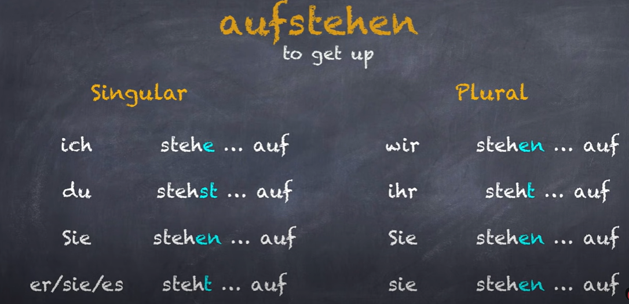

Slide 4
Trennbare Verbs
1. Mitkommen = to come along/ come with
Ex. Wir gehen zu der Uni, kommst du mit?
2. Abholen = to pick something or someone up
Ex – Kannst du mich um 18 Uhr abholen?
Ich hole dich um 7 uhr ab.
3. Abfahen = to leave / depart (flight/ train etc)
4. Ankommen = to arrive
5. Anfangen = to begin
6. Einkaufen = to shop
7. Fernsehen = to watch tv
8. Anrufen = to call
9. Einladen = to invite
10. Zumachen = to close / shut

Slide 5
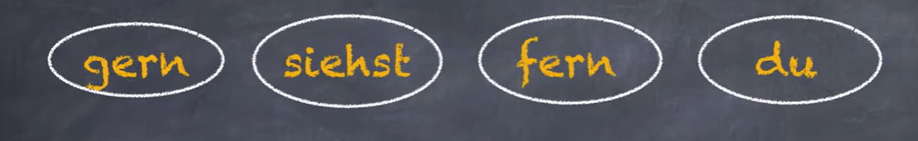
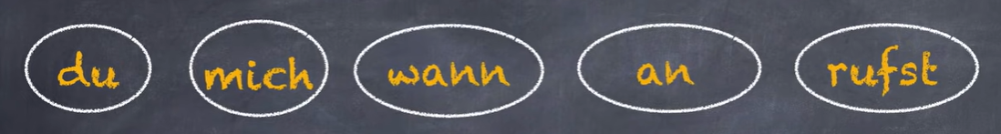
Übung – Bilden Sie die Sätze – Der Hinweis – sie sind die Fragen
1.
2.
Hausaufgabe - Find out the below verbs in German and conjugate them.
To sleep
To wake up
To take bath
To eat
To go
To come
To study
To have

Slide 6
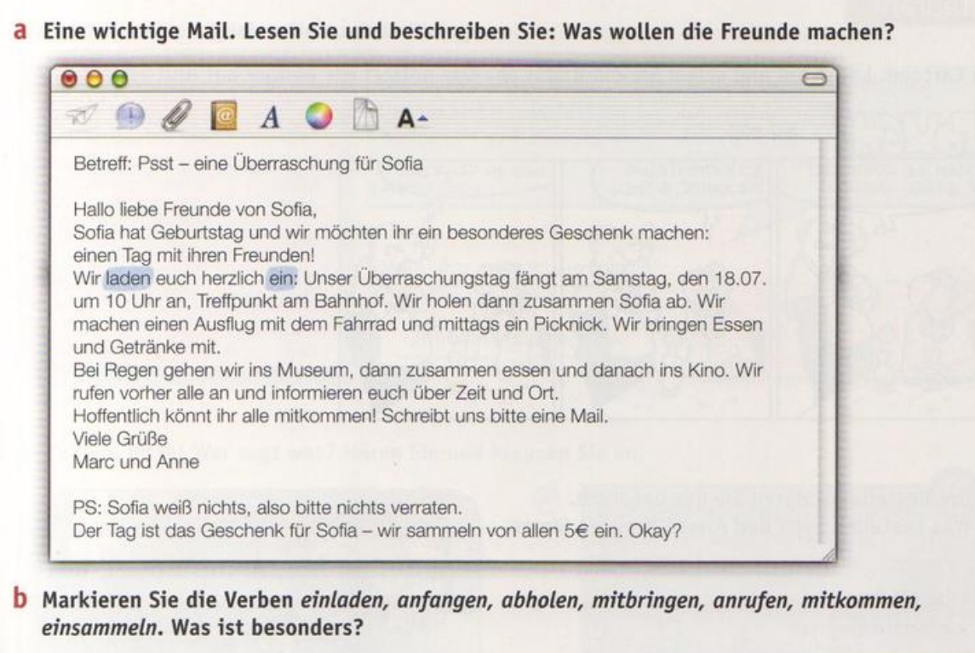

Slide 7
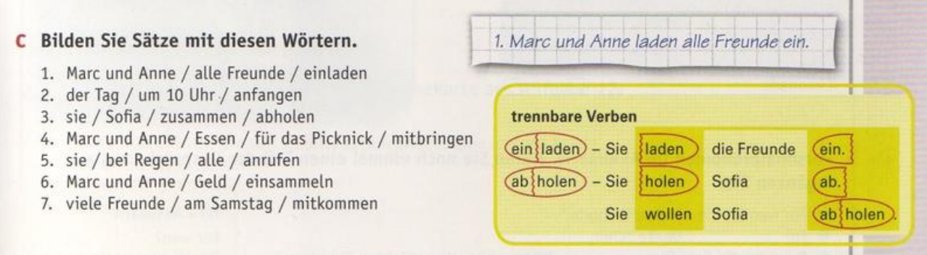
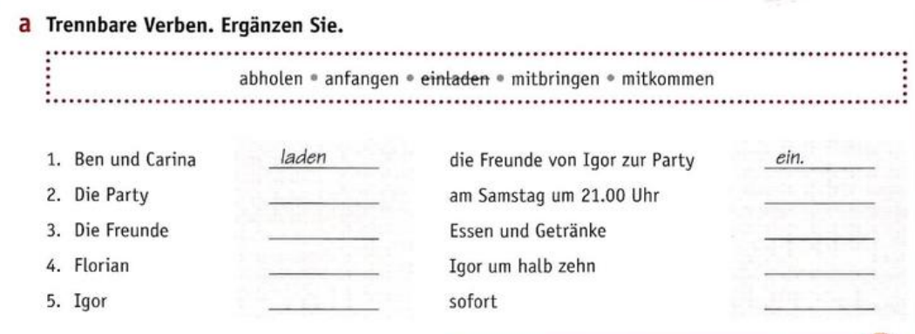

Slide 8
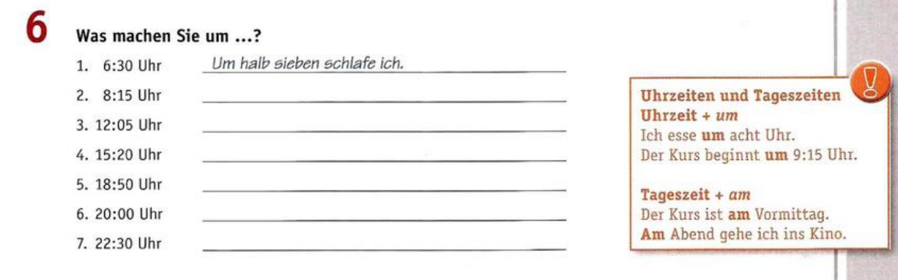
Der Tagesablauf – Daily routine (der Wortschatz – vocabulary)
Das Frühstück = Breakfast
Die Zahnbürste = Toothbrush
Der Tee/ Kaffee = tea/ coffee
Das Wasser = water
Das Haus = house
Hausaufgabe :
List out other words (verbs and nouns) in your day to day routine.
Find out plurals for above nouns

